Slide 1


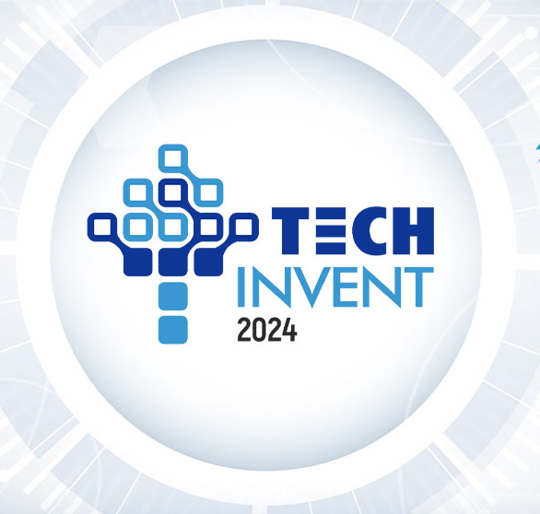

Smart Transport Management System
Presented
in
Next Wave Urban Solutions: An Ideathon
Name of Team Members
TEPPALA NIRAJ (22BAI71402)
K SAIKAMAL (22BAI70323)
SAGAR SINGH (22BCS13400) G MALLESH YADAV (22BAI71298)
Y V BADRINATH REDDY (22BAI70407)
CSE-AIT
Chandigarh University
Mohali,Punjab

Slide 2
Table of Contents
Future Scope and SDG Goals
References
09
Methodology
07
Literature Review
05
Introduction
03
01
08
06
Conclusion
04
Working Model
02
Frameworks and Innovations
Problem Solution

Slide 3
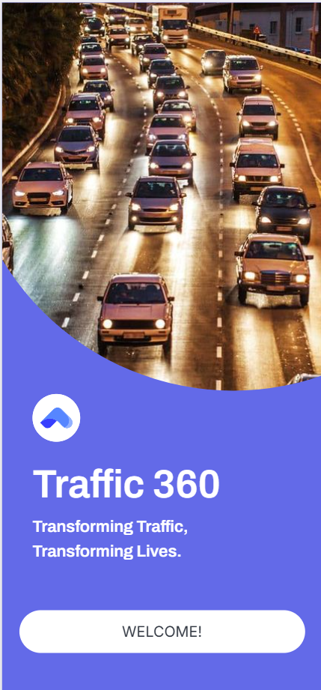
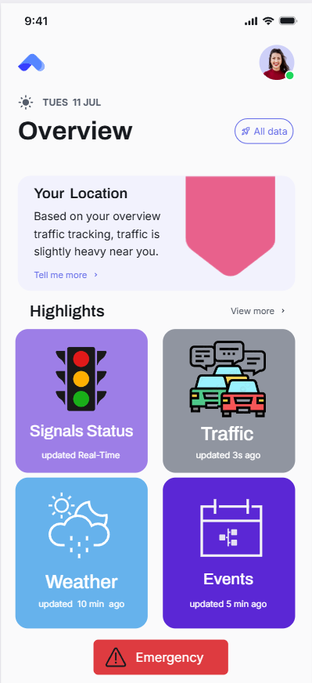
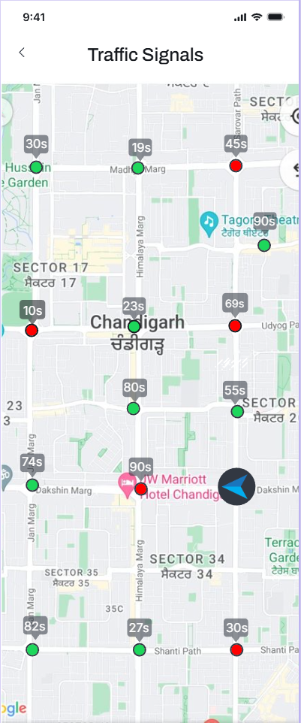
Introduction
Smart Traffic Management System
Urban traffic congestion is a major challenge, causing significant delays, increased pollution, and higher accident rates. Traditional traffic management systems struggle to adapt in real-time to dynamic factors like traffic flow variations, weather changes, and special events, leading to inefficient road usage and longer travel times.
Smart Traffic Management Systems (STMS) use advanced technologies like IoT sensors, AI-driven analytics, and real-time data integration to transform urban mobility. By leveraging computer vision for vehicle detection and predictive algorithms for traffic forecasting, STMS optimizes signal timing, reduces congestion, and enhances the overall driving experience, improving road safety and efficiency.

Slide 4
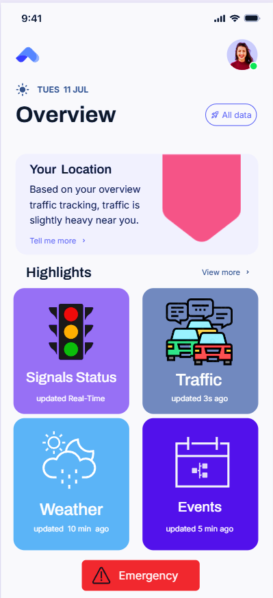
Problem Solution
PROBLEM SOLUTION: Smart Traffic Management System
KEY FEATURES of Management System:
Real-Time Data Collection: CCTV cameras with YOLO detect vehicles, while a Kalman Filter adjusts traffic signals in real-time to optimize flow.
Data Acquisition
Weather Handling: Integrates GPS and Weather API to provide real-time updates, helping drivers navigate safely during adverse conditions.
Weather Updates
Special Event Handling: Uses an event database and Maps API to offer alternative routes, minimizing congestion during major events.
Event Management
Emergency Services: YOLO detects emergency vehicles, enabling dynamic traffic signal overrides. User reports enable rapid adjustments.
Priority Passage
Data Analysis: LSTM predicts traffic patterns, enabling predictive signal adjustments for optimized flow.
Traffic Prediction
Feedback Mechanism: Enhances accuracy by learning from real-time data for smarter traffic adjustments.
Self-improvement
CENTRAL SYSTEM

Slide 5
Literature Review
KALMAN FILTER
YOLO
The Kalman Filter, developed by Rudolf Kalman in 1960, improves estimates of unknown variables by combining noisy measurements over time. It’s widely used in fields like navigation, signal processing, and control systems. In traffic management and computer vision, it enhances accuracy in tracking and predicting movement.
YOLO, created by Joseph Redmon et al. in 2015, is a real-time object detection algorithm that treats detection as a single regression task, predicting bounding boxes and class probabilities from entire images. It offers much faster detection than traditional methods like R-CNN, making it ideal for real-time applications, including traffic management and computer vision.
Object Tracking: Predicts and updates the position of moving objects (vehicles, pedestrians) using past data, smoothing noisy detections for more accurate tracking.
Traffic Flow Estimation: Estimates vehicle speed, count, and density from noisy sensor data, enhancing real-time traffic signal optimization.
Sensor Fusion: Combines data from multiple sensors (e.g., cameras, radar) to improve vehicle detection accuracy and traffic environment understanding.
Vehicle and Pedestrian Detection: YOLO efficiently detects and classifies vehicles (cars, buses, motorcycles) and pedestrians in real-time traffic camera feeds, enhancing intelligent traffic systems with rapid response
capabilities. Adaptive Traffic Signal Control: YOLO's vehicle detection output enables adaptive signal control, optimizing signal timings based on detected vehicle count and type in each lane for better traffic management.
Key Studies and Applications:
Vehicle Tracking: Comaniciu et al. (2003) demonstrated the Kalman Filter's effectiveness in predicting vehicle positions in surveillance videos, even during occlusions, enhancing traffic monitoring by maintaining continuous tracking.
Traffic State Estimation: Wang and Papageorgiou (2005) applied the Kalman Filter for real-time traffic density and flow estimation, improving prediction accuracy and supporting dynamic congestion management.
Key Studies and Applications:
Real-Time Traffic Analysis: Li et al. (2019) demonstrated YOLO's high detection accuracy and low latency for real-time vehicle detection on highway surveillance videos, proving its value for dynamic traffic management.
Smart City Applications: Zhang et al. (2020) highlighted YOLO's role in smart city platforms for automatic incident detection and traffic monitoring, with its live camera feed processing enabling timely traffic management decisions.

Slide 6
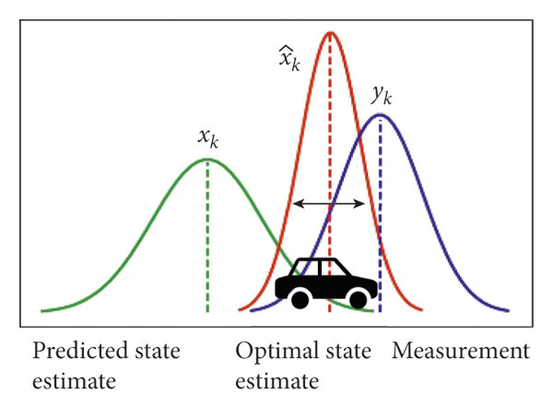
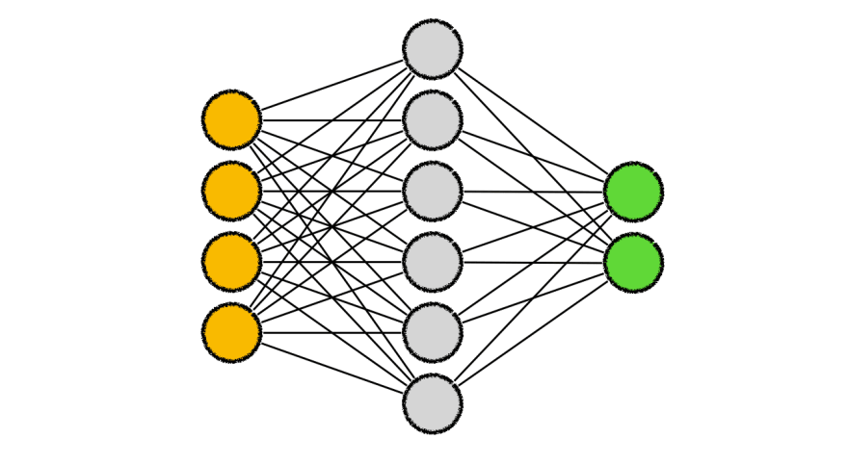


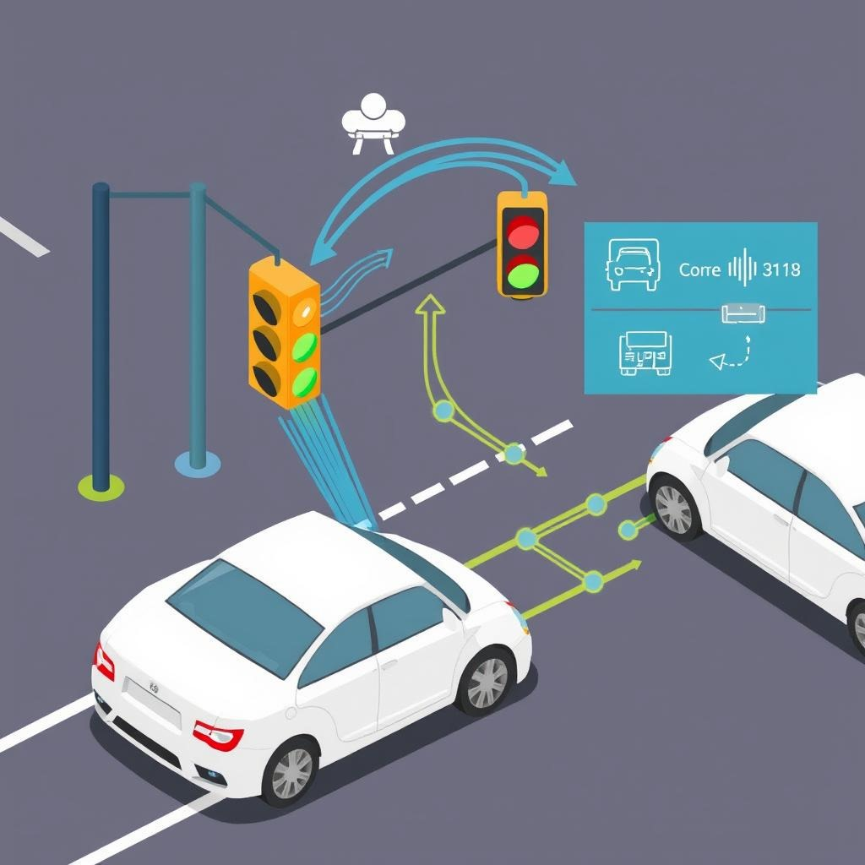
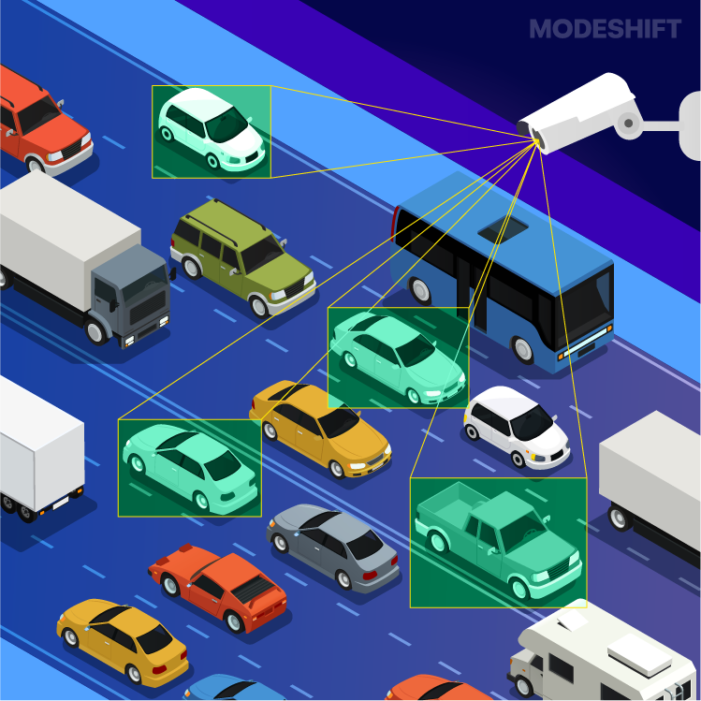

Frameworks and Innovations
Kalman Filter
Predicts and
Refines traffic flow
CNN
Classifies traffic signs and objects
Computer Vision (CV)
Detects and classifies
Vehicles in real time.
V2I Communication
Connects vehicles with
traffic infrastructure
FRAMEWORK
YOLO
Real-time object
detection model.
Feedback Mechanism Continuously improves
using real-time data

Slide 7
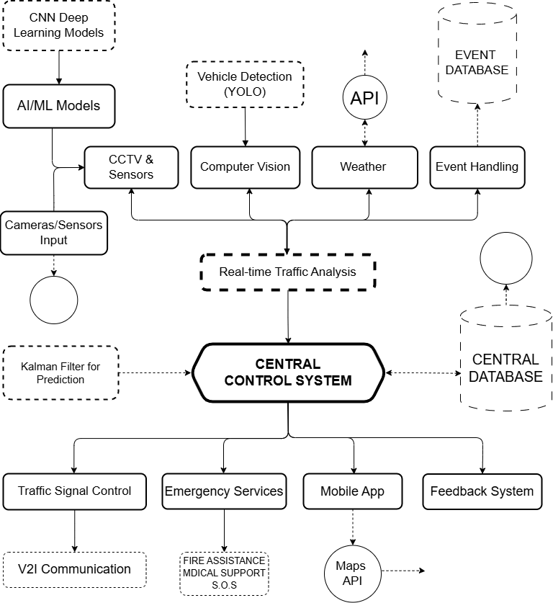



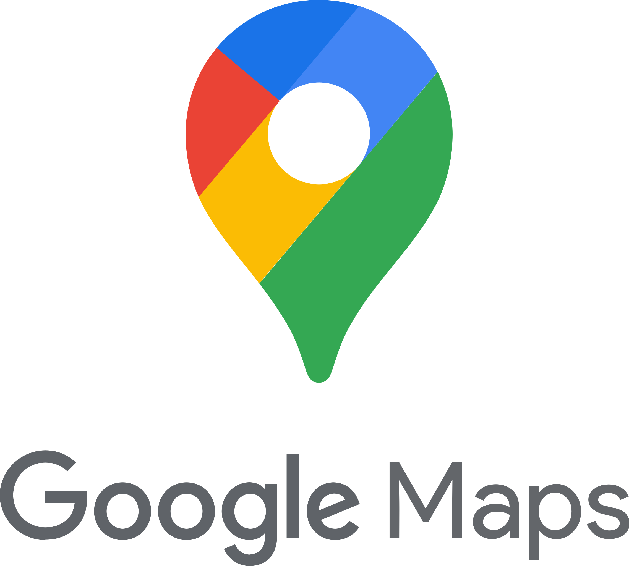
Methodology
Data Collection: Cameras and sensors detect real-time traffic flow, with YOLO for vehicle detection and classification.
Traffic Prediction: Kalman filter and AI/ML models forecast traffic patterns, optimizing flow and reducing congestion.
Event & Weather Handling: The system integrates special events and weather data to adjust traffic control dynamically.
Real-Time Analysis: The Central Control System processes real-time data for traffic optimization.
Signal Control & V2I: Adaptive traffic signals and Vehicle-to-Infrastructure communication streamline traffic and inform drivers.
User Interface: A mobile app provides real-time updates, alternate routes, and gathers user feedback for continuous improvement.

Slide 8
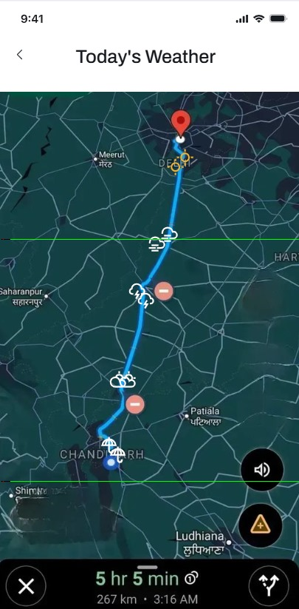
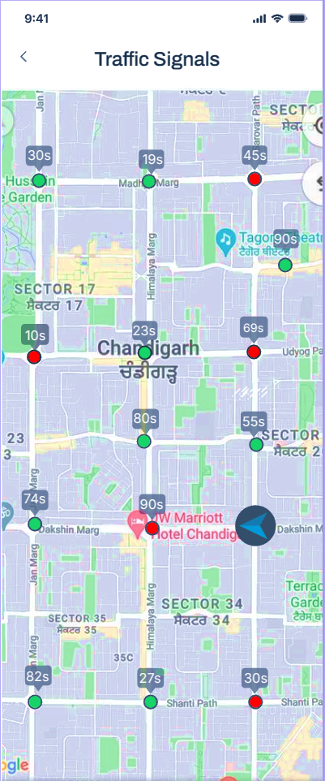
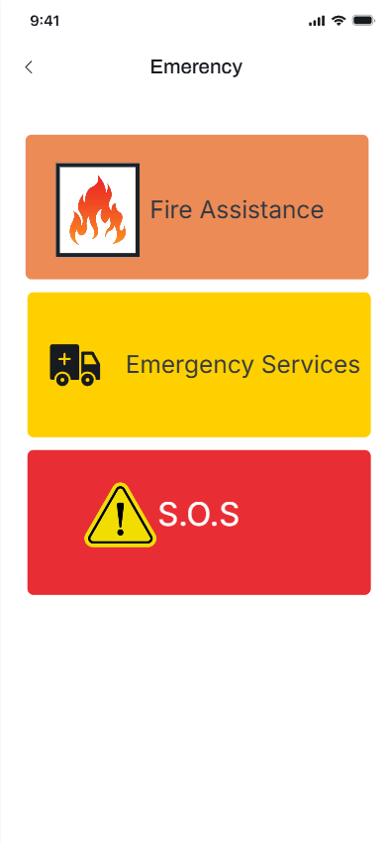
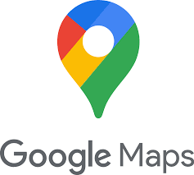





Working Model
TECHNICAL STACK
KALMAN FILTER
The Working Model of our Smart Traffic Management System leverages cutting-edge AI and IoT to seamlessly adapt to dynamic urban conditions. It integrates real-time vehicle detection using YOLO, predictive traffic signal optimization via Kalman Filter, and live weather data to intelligently adjust routes. The system's mobile app provides commuters with proactive traffic updates and personalized route suggestions, revolutionizing urban mobility for a smoother, safer, and smarter travel experience.

Slide 9


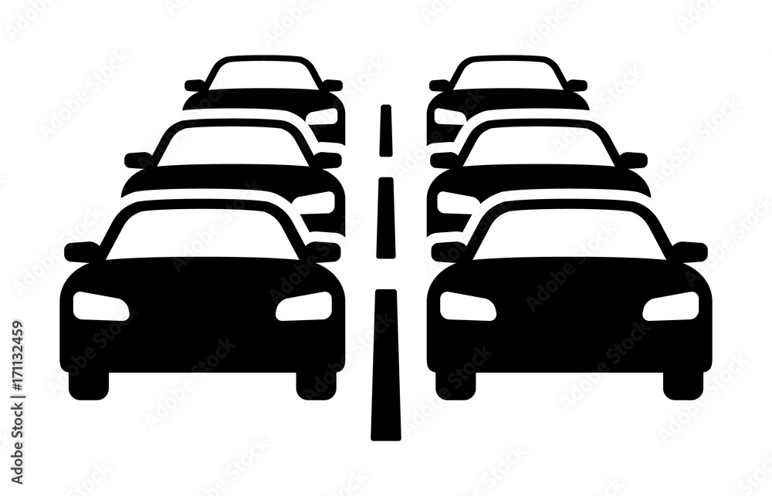



Sustainable Development Goals (SDG)
GOAL 9: Industry, Innovation, and Infrastructure
Long-term Impact: Contribution to the Goals
Enhances Urban Infrastructure
Fosters Technological Innovation
Supports Industrial Growth
Measurability: Can the Impact Be Measured?
SIGNIFICANCE:
Reduced Travel Times: 20-30% faster travel through optimized signals.
Decreased Traffic Congestion: 25-35% less congestion during peak hours.
Enhanced Safety: Fewer weather-related incidents with real-time data.
Improved Emergency Response Times: 15-20% faster response for emergency vehicles.
Environmental Benefits: Lower emissions through reduced idle time.
Infrastructure Efficiency
Technology Adoption
Economic Impact
Infrastructure Resilience

Slide 10
Autonomous Vehicle Integration:
Direct communication with autonomous vehicles for smoother, optimized traffic flow.
Smart City Integration:
FUTURE
SCOPE
Expand into smart city systems for unified urban management.
AI-Predictive Traffic Management:
Anticipate traffic patterns, enabling preemptive signal control and congestion avoidance.
Urban Planning Support:
Use AI-driven traffic data for long-term urban infrastructure planning.
Enhanced Emergency Response:
Create AI-driven "green corridors" for faster emergency vehicle response.
Crowdsourced Data Use:
Incorporate user-reported incidents for real-time traffic optimization.
Sustainability Impact:
Optimize routes to reduce emissions and promote eco-friendly traffic solutions.

Slide 11
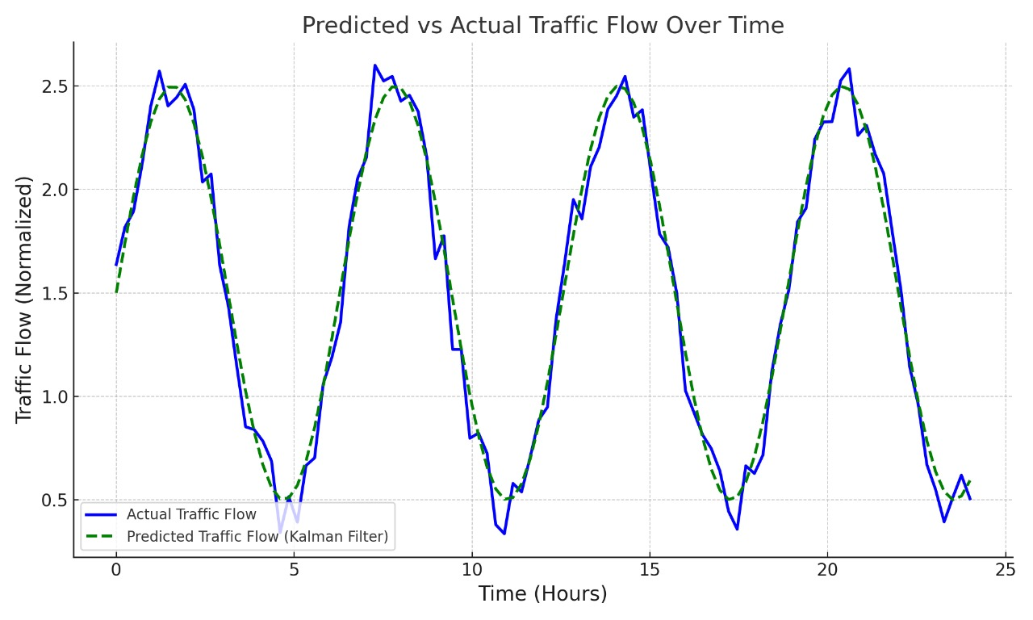

Conclusion
Scalability
City-Wide Traffic Management Expansion
Adaptable to Various Urban Sizes
Integrates with Existing Infrastructure
Supports Future Technology Upgrades
Easily Deployable Across Regions
The Smart Traffic Management System (STMS) leverages AI-driven traffic signal optimization and real-time data integration to enhance urban mobility. By utilizing IoT for traffic monitoring and incorporating weather analytics, it reduces congestion and improves emergency response times. This system facilitates efficient traffic flow, significantly elevating commuter safety and quality of life.

Slide 12
References
Zhao, Y., & Zhang, H. (2016). "Real-Time Traffic State Estimation Using Kalman Filter and Floating Car Data." Journal of Transportation Engineering, 142(2), 04015036. DOI: 10.1061/(ASCE)TE.1943-5436.0000816
Hartenstein, H., & Laberteaux, K. P. (2010). "A Tutorial Survey on Vehicle-to-Vehicle and Vehicle-to-Infrastructure Communication." IEEE Communications Surveys & Tutorials, 12(4), 551-581. DOI: 10.1109/SURV.2010.030410.00176
Redmon, J., Divvala, S., Girshick, R., & Farhadi, A. (2016). "You Only Look Once: Unified Real-Time Object Detection." Proceedings of the IEEE Conference on Computer Vision and Pattern Recognition (CVPR), 779-788. DOI: 10.1109/CVPR.2016.91
Khan, A. A., & Lee, S. (2019). "Traffic management system based on IoT and smart cities." Journal of Network and Computer Applications, 135, 84-98. DOI: 10.1016/j.jnca.2019.01.017
Kim, T., & Lee, Y. (2018). "Real-time vehicle detection using deep learning based object detection methods." Journal of Ambient Intelligence and Humanized Computing, 9(4), 1271-1280. DOI: 10.1007/s12652-017-0677-1

